Slide 1
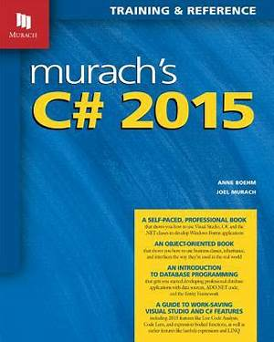
Programming
Lecture 12
Windows Form Part 3

Slide 2
Agenda
Multi form
Pass data 2 form
User Control
Tab Control

Slide 3
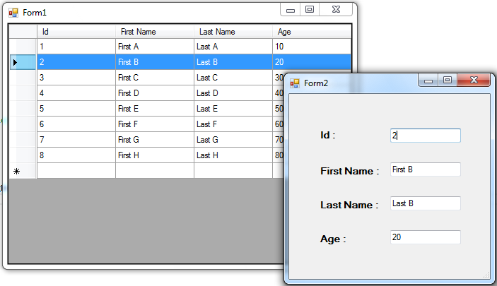
Multi form
Example: Design 2 forms (List and Detail)
There aren't many programmes that have only one form. Most programmes have other forms that are accessible from the main one that loads at startup. In this section, you'll learn how to create programmes with more than form.

Slide 4
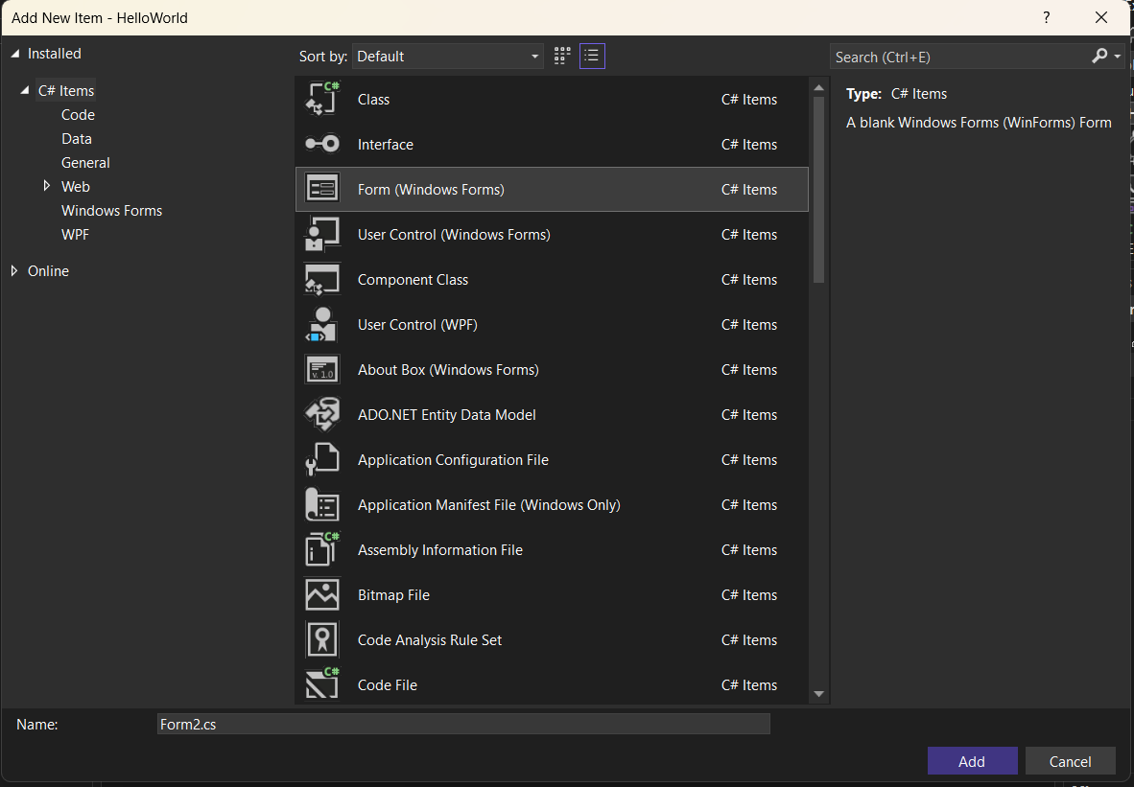
Multi form
Create other Form (Form2.cs)

Slide 5
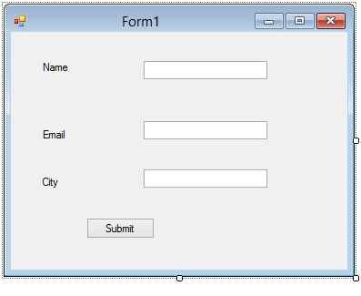
Multi form
Design Form 1

Slide 6
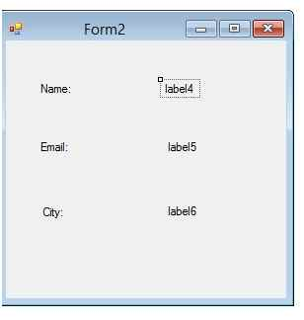
Multi form
Design Form 2

Slide 7
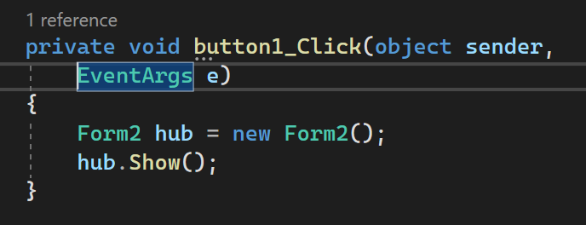
Transition 2 form
Create Event onClick to transition between Form 1 and Form 2

Slide 8
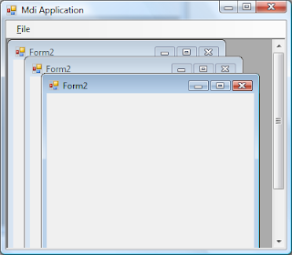
Multi form
Activity 1
Create 4 forms and when clicking on the button in the forms, display 1 random form

Slide 9
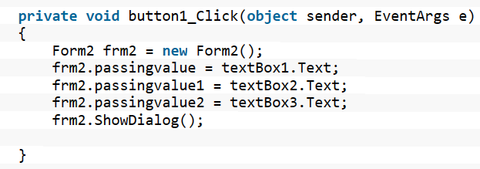
Pass Data
Pass Data between 2 form

Slide 10
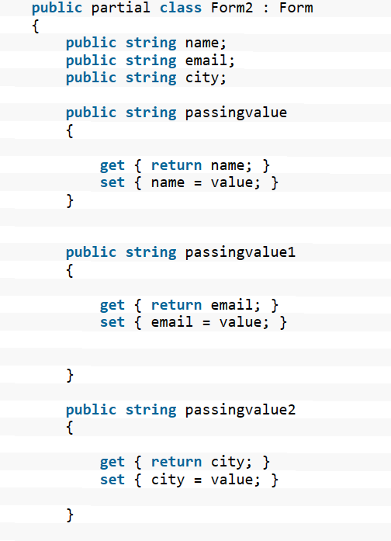
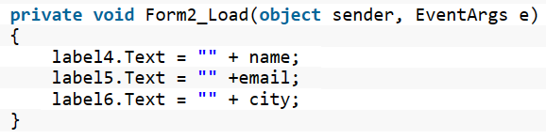
Pass Data
Pass Data between 2 form

Slide 11
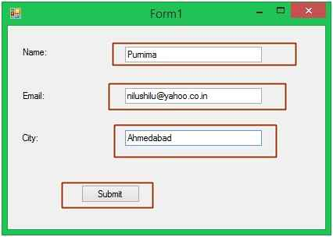
Pass Data
Output

Slide 12
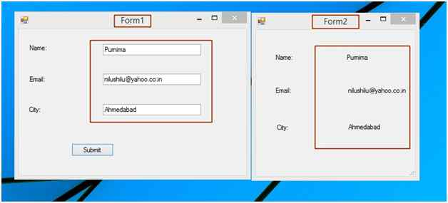
Pass Data
Output

Slide 13
User Control
What is User Control?
A UserControl is a ContentControl, which means that it can contain a single object of any type (such as a string, an image, or a panel).
C# user control is defined as an implementation in programming language of C# to provide an empty control and this control can be leveraged to create other controls.

Slide 14
User Control
Why make User Control
Re-use flexibility with large scale project.
Help find bug and resolve bug in short time.
write code at one place (user control) that effect in every web form or every Form of window application.
save your time.

Slide 15
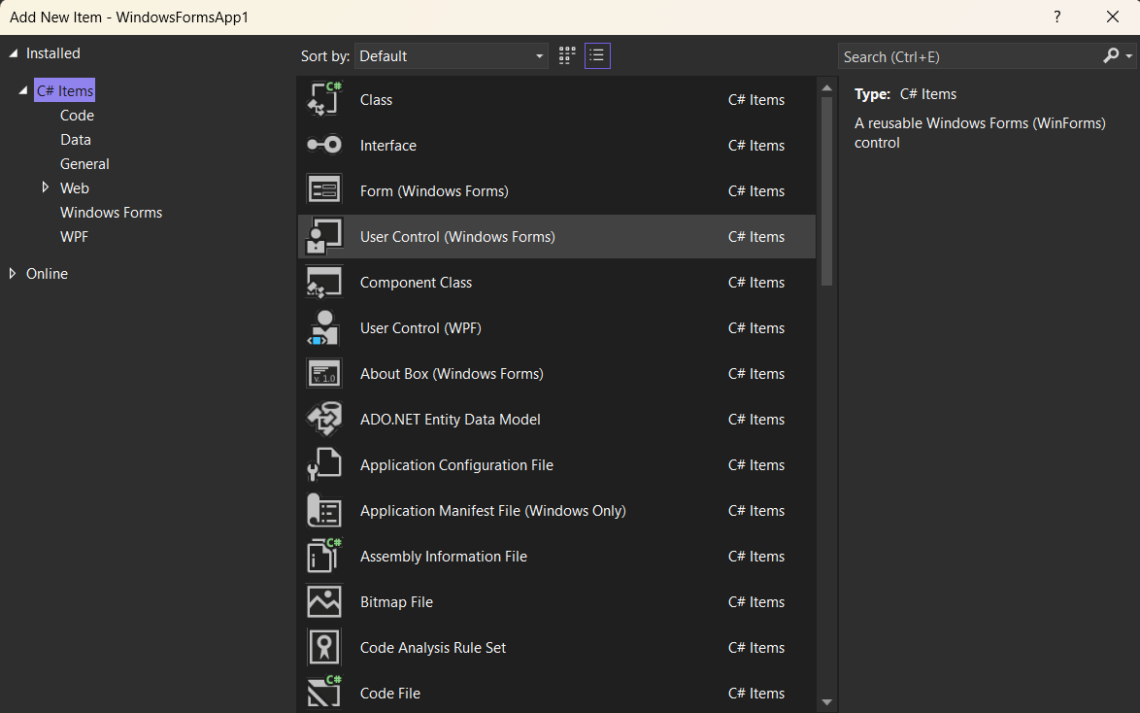
User Control
Add New Item - User Control

Slide 16
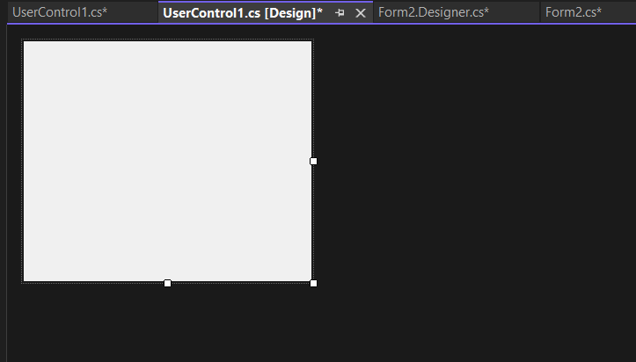
User Control
Add New Item - User Control

Slide 17
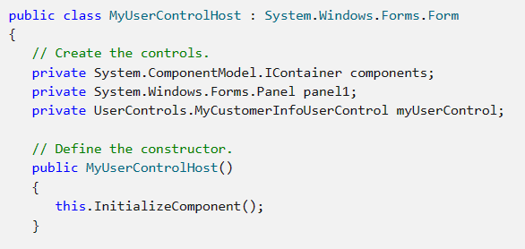
User Control
Declare User Control in Form

Slide 18
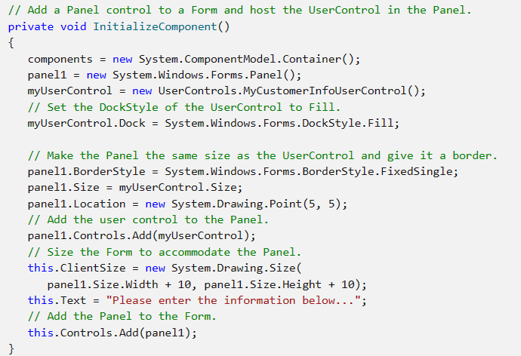
User Control
Construct UserControl in InitializeComponent()

Slide 19
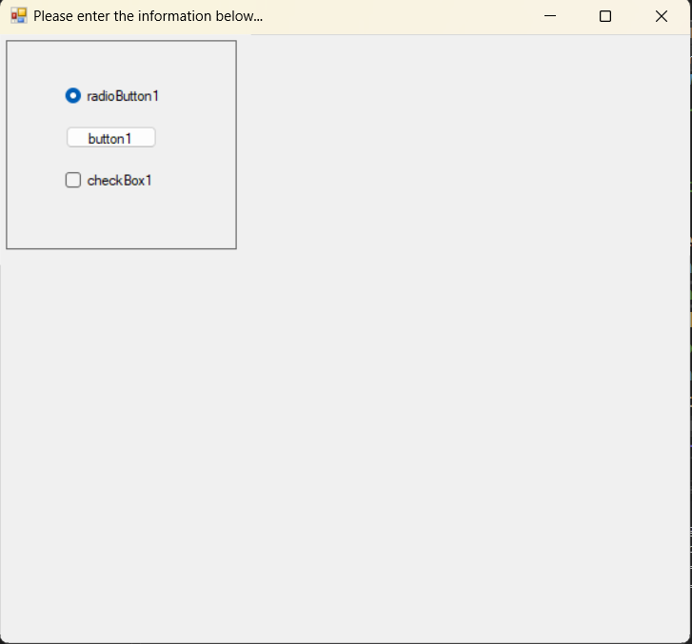
User Control
Result like bellow

Slide 20
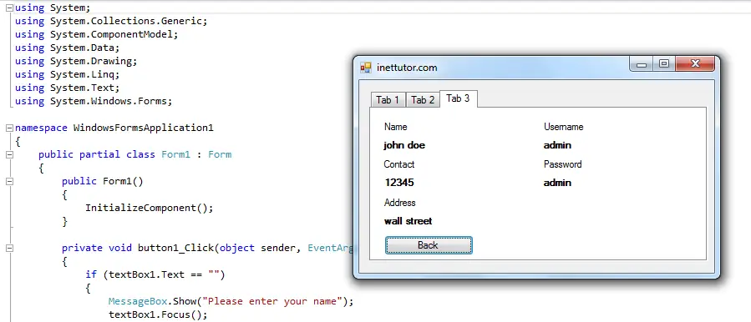
Tab Control
Definition
Tab control allows you to create a multiple-page like in your windows form. This control allows you to organize other controls in your c# project; this property of tab control is tab pages.
There can several tab pages in a tab control and a tab page can contain different controls like textbox, combobox, etc.

Slide 21
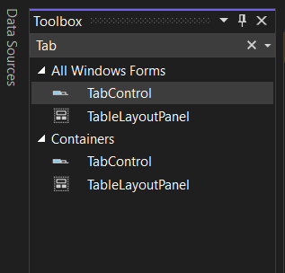
Tab Control
Add Tab Control in Toolbox

Slide 22
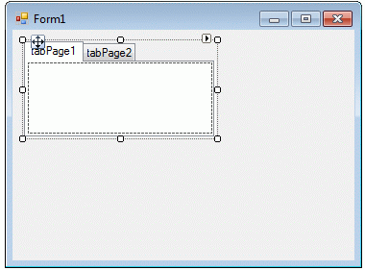
Tab Control
Add TabPage in Design

Slide 23
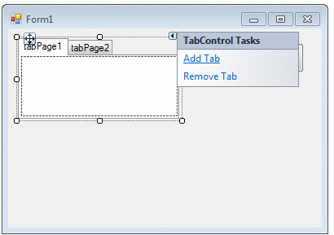
Tab Control
Add TabPage in Design

Slide 24
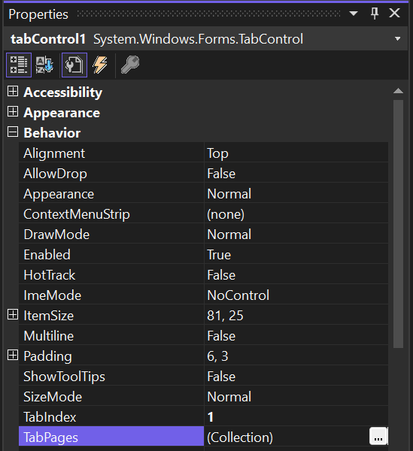
Tab Control
Add more TabPage
In Properties, select Behavior -> TabPages -> Collection

Slide 25
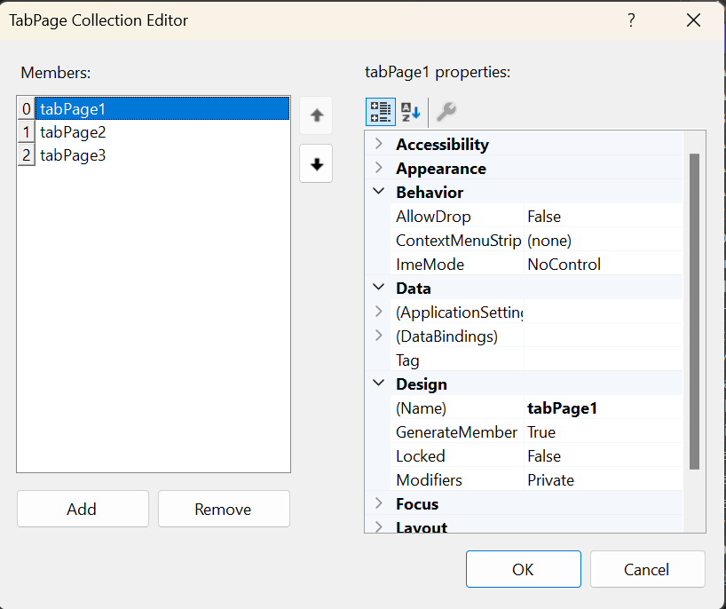
Tab Control
Add more TabPage
Click Add Button to generate a new TabPage

Slide 26
Tab Control
Add/Remove TabPage
Click Add Button to generate a new TabPage
Click Remove to remove TabPage

Slide 27
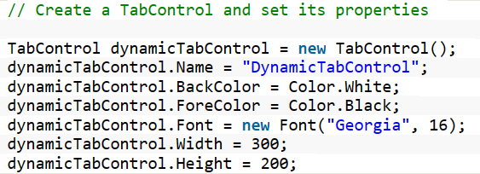
Tab Control
Add TabControl in Run-time

Slide 28
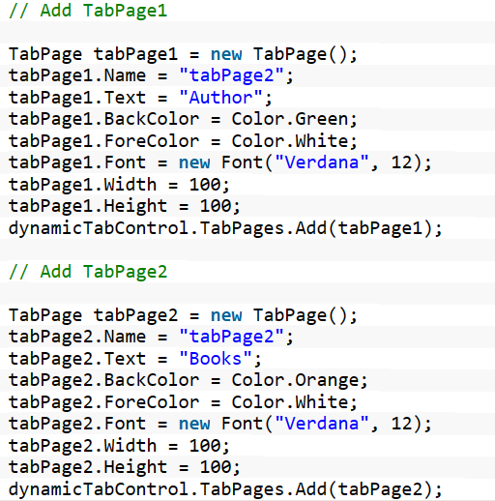
Tab Control
Add TabPage in Run-time

Slide 29
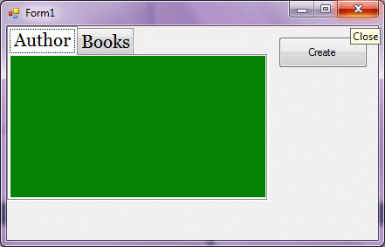
Tab Control

Slide 30
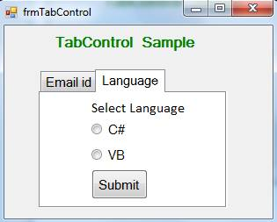
Practise
Create Tab control Sample project like bellows figure

Slide 31
Question
List of questions
How to bind a TabControl with a collection of TabItems
C# vertical tab control with horizontal text

Slide 32
Thank you!
Notes:
32

